Slide 1

Department of FOT
01CE0101 - Computer Programming
Unit - 4
Array and String

Slide 2
Arrays
An array is a collection of data items, all of the same type, accessed using a common name.
Array is a data structure that hold finite sequential collection of homogeneous data.
Array is a collection - Array is a container that can hold a collection of data.
Array is finite - The collection of data in array is always finite, which is determined prior to its use.
Array is sequential - Array stores collection of data sequentially in memory.
Array contains homogeneous data - The collection of data in array must share a same data type.

Slide 3
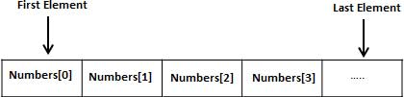
Arrays
Examples:
- List of customers and their phone numbers
-Table of daily rainfall data
- List of employees in an organization
- Test scores of a class of students and so on….
Structure of array:

Slide 4
Declaration of Arrays
Array variables are declared identically to variables of their data type, except that the variable name is followed by one pair of square [ ] brackets for each dimension of the array.
Syntax:
type arrayName [ arraySize ];
Example:
int group[10];
float height[50];
char name[15];

Slide 5
Initialization of Arrays
After an array is declared, its elements must be initialized.
There are two ways to initialize an array.
Static array initialization - Initializes all elements of array during its declaration.
Dynamic array initialization - The declared array is initialized some time later during execution of program.

Slide 6
Static initialization of array
We define value of all array elements within a pair of curly braces { and } during its declaration.
Values are separated using comma, and must be of same type.
Example
int marks[5] = {90, 86, 89, 76, 91};

Slide 7
Dynamic initialization of array
You can assign values to an array element dynamically during execution of program. First declare array with a fixed size.
Then use the following syntax to assign values to an element dynamically.
Syntax:
array_name[index] = some_value;
EX:
scanf("%d",&arr[i]);

Slide 8
Advantages and Disadvantages
Advantages:
Use of less line of code as it creates a single array of multiple elements.
Random access of elements using array index.
Easy access to all the elements.
Traversal through the array becomes easy using a single loop.
Sorting becomes easy as it can be accomplished by writing less line of code.
Disadvantages:
Insertion and deletion of elements can be costly since the elements are needed to be managed in accordance with the new memory allocation.
Allows a fixed number of elements to be entered which is decided at the time of declaration. Unlike a linked list, an array in C is not dynamic.

Slide 9
Types of Arrays
One-dimensional arrays(single)
Two-dimensional arrays
Multidimensional arrays

Slide 10
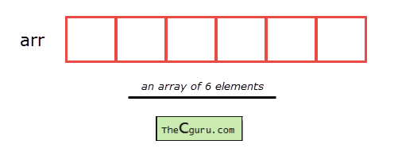
One – Dimensional Array
A one-dimensional array as a row, where elements are stored one after another.
Syntax: datatype array name[size];
Where ….
datatype: It denotes the type of the elements in the array.
array name: Name of the array. It must be a valid identifier.
size: Number of elements an array can hold. here are some example of array

Slide 11
Accessing elements of an array
The elements of an array can be accessed by specifying array name followed by subscript or index inside square brackets (i.e []).
Array subscript or index starts at 0. If the size of an array is 10 then the first element is at index 0, while the last element is at index 9.
The first valid subscript (i.e 0) is known as the lower bound, while last valid subscript is known as the upper bound.

Slide 12
Accessing elements of an array
Example:
int a[5];
then elements of this array are;
First element – a[0]
Second element – a[1]
Third element – a[2]
Fourth element – a[3]
Fifth element – a[4]

Slide 13
Accessing elements of an array
Array subscript or index can be any expression that yields an integer value.
For example:
int a[5];
int i = 0, j = 2;
a[i]; // 1st element
a[i+1]; // 2nd element
a[i+j]; // 3rd element
In the array a, the last element is at a[4],

Slide 14
Example Program
#include<stdio.h>
int main()
{
int a[5], i;
for(i = 0; i < 5; i++)
{
printf("Enter a[%d]: ", i);
scanf("%d", &a[i]);
}
printf("\nPrinting elements of the array: \n\n");
for(i = 0; i < 5; i++)
{
printf("%d ", a[i]);
}
return 0;
}

Slide 15
Example Program
1. Write down a program to enter 20 elements in an array and print the elements in reverse order.
2. Write a program to add all the elements in an array.
3.Write a program to copy one array to another array.
4. Write a program to find out all the even and odd numbers present in an array.
5. Write a program to swap two arrays.

Slide 16
Two-Dimensional Array in C
Two – dimensional array is the simplest form of a multidimensional array.
The two-dimensional array can be defined as an array of arrays.
The 2D array is organized as matrices which can be represented as the collection of rows and columns.
It provides ease of holding the bulk of data at once.

Slide 17
Declaration of two dimensional Array in C
Syntax:
datatype array_name[rows][columns];
Where:-
datatype: It denotes the type of the elements in the array.
array name: Name of the array. It must be a valid identifier.
Row – size of rows
Column – size of column

Slide 18
Initializing Two – Dimensional Arrays
There are two ways in which a Two-Dimensional array can be initialized.
First Method:
int x[3][4] = {0, 1 ,2 ,3 ,4 , 5 , 6 , 7 , 8 , 9 , 10 , 11}
The above array have 3 rows and 4 columns. The elements in the braces from left to right are stored in the table also from left to right. The elements will be filled in the array in the order, first 4 elements from the left in first row, next 4 elements in second row and so on.
Better Method:
int x[3][4] = {{0,1,2,3}, {4,5,6,7}, {8,9,10,11}};

Slide 19
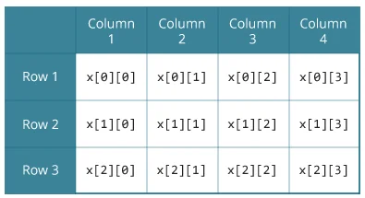
Accessing the 2- D Arrays
arr[0][0] = 1
arr[0][1] = 2
arr[0][2] = 3
arr[1][0] = 2
arr[1][1] = 3
arr[1][2] = 4
arr[2][0] = 3
arr[2][1] = 4
arr[2][2] = 5

Slide 20
Example
#include <stdio.h>
int main ()
{
int a[3][3],i,j;
for (i=0;i<3;i++) // for row
{
for (j=0;j<3;j++) // for column
{
printf("Enter a[%d][%d]: ",i,j);
scanf("%d",&a[i][j]);
}
}

Slide 21
Example
printf("\n printing the elements ....\n"); // Printing
for(i=0;i<3;i++)
{
printf("\n");
for (j=0;j<3;j++)
{
printf("%d\t",a[i][j]);
}
}
return 0;
}

Slide 22
Sorting operation using array
The process of Sorting can be explained as a technique of rearranging the elements in any particular order, which can be set ready for further processing by the program logic.
We can easily sort a list of elements by means of iterations and condition check statements.
We require one outer loop and one inner loop and one swap function to do the purpose.

Slide 23
Sorting operation using array
We can do sorting the elements in 2 ways
Ascending order
Descending order

Slide 24
Sorting operation –Example
#include <stdio.h>
int main()
{
int a[5],i,j,temp = 0;
printf("Enter the Elements of array: \n");
for(i = 0; i < 5; i++)
{
scanf("%d", &a[i]);
}
for (i = 0; i < 5; i++)
{
for (j = i+1; j < 5; j++)
{
if(a[i] > a[j])
{
temp = a[i];
a[i] = a[j];
a[j] = temp;
}
}
}
printf("\n");
printf("Elements of array sorted in ascending order: \n");
for (i = 0; i <5; i++)
{
printf("%d ", a[i]);
}
return 0;
}

Slide 25
Matrix operation using array
A matrix is a grid that is used to store data in a structured format.
It is often used with a table, where the data is represented in horizontal rows and vertical columns.
Addition, subtraction and multiplication are the basic operations on the matrix.
Matrix multiplication in C language to calculate the product of two matrices (two-dimensional arrays). A user inputs the orders and elements of the matrices.

Slide 26
Matrix operation using array
In programming if the user wants to multiply, add, subtract and divide two matrices, then the order of the matrix should be declared first.
A matrix that contains the same number of rows and columns then it is called a square matrix.
Matrix is used to store a group of related data. Some of the programming languages are used to support matrices as a data type that offers more flexibility than a static array.
Instead of storing the values in a matrix, it can be stored as an individual variable, a program can access and perform operations on the data more efficiently.

Slide 27
Algorithm for Matrix Multiplication
Step 1: Start the Program.
Step 2: Enter the row and column of the first (a) matrix.
Step 3: Enter the row and column of the second (b) matrix.
Step 4: Enter the elements of the first (a) matrix.
Step 5: Enter the elements of the second (b) matrix.
Step 6: Print the elements of the first (a) matrix in matrix form.

Slide 28
Algorithm for Matrix Multiplication
Step 7: Print the elements of the second (b) matrix in matrix form.
Step 8: Set a loop up to row.
Step 9: Set an inner loop up to the column.
Step 10: Set another inner loop up to the column.
Step 11: Multiply the first (a) and second (b) matrix and store the element in the third matrix (c)
Step 12: Print the final matrix.
Step 13: Stop the Program.

Slide 29
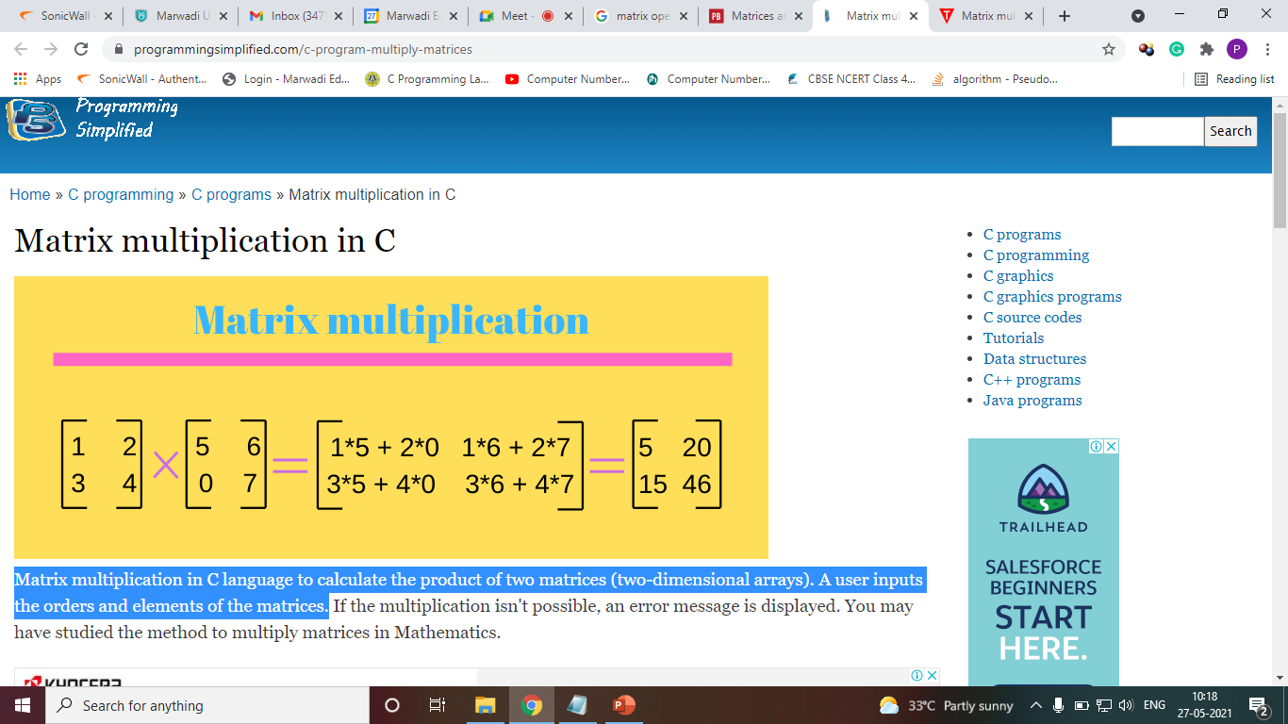
Matrix Multiplication

Slide 30
Matrix Multiplication
#include<stdio.h>
int main()
{
int a[10][10],b[10][10],mul[10][10],r,c,i,j,k;
printf("enter the number of row=");
scanf("%d",&r);
printf("enter the number of column=");
scanf("%d",&c);
printf("enter the first matrix element=\n");
for(i=0;i<r;i++)
{
for(j=0;j<c;j++)
{
scanf("%d",&a[i][j]);
}
}
printf("enter the second matrix element=\n");
for(i=0;i<r;i++)
{
for(j=0;j<c;j++)
{
scanf("%d",&b[i][j]);
}
}
printf("multiply of the matrix=\n");
for(i=0;i<r;i++)
{
for(j=0;j<c;j++)
{
mul[i][j]=0;
for(k=0;k<c;k++)
{
mul[i][j]+=a[i][k]*b[k][j];
}
}
}
//for printing result
for(i=0;i<r;i++)
{
for(j=0;j<c;j++)
{
printf("%d\t",mul[i][j]);
}
printf("\n");
}
return 0;
}

Slide 31
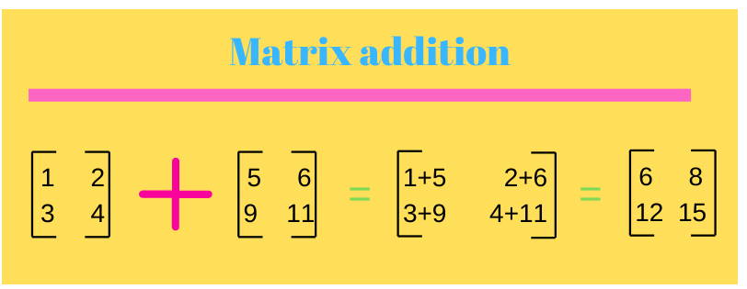
Matrix addition

Slide 32
Matrix Addition
#include <stdio.h>
int main()
{
int m, n, c, d, first[10][10],second[10][10],sum[10][10];
printf("Enter the number of rows and columns of matrix\n");
scanf("%d%d",&m,&n);
printf("Enter the elements of first matrix\n");
for (c = 0; c < m; c++)
{
for (d = 0; d < n; d++)
{
scanf("%d",&first[c][d]);
}
}
printf("Enter the elements of second matrix\n");
for (c = 0; c < m; c++)
{
for (d = 0 ; d < n; d++)
{
scanf("%d", &second[c][d]);
}
}
printf("Sum of entered matrices:-\n");
for (c = 0; c < m; c++)
{
for (d = 0 ; d < n; d++)
{
sum[c][d] = first[c][d] + second[c][d];
printf("%d\t", sum[c][d]);
}
printf("\n");
}
return 0;
}

Slide 33
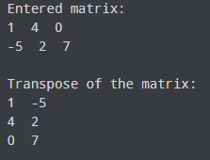
Exercise
Program to Find the Transpose of a Matrix

Slide 34
Strings

Slide 35
Character
char is a C data type designed for the storage of letters.
A char takes a memory size of 1 byte. It also stores a single character.
Example :
char a;
scanf (“%c”, &a);
printf (“%c”, a);

Slide 36
Strings
A sequence of characters that is treated as a single data item.
itle String
Group of characters defined between double quotation marks.
“ You are the best. ”

Slide 37
Declaration of String
Since string is an array, the declaration of a string is the same as declaring a char array.
Syntax:
char string-name[ size ];
Example :
char subject [10];

Slide 38

Initializing String variables
The string is always ended with a null character ‘\0’.
The characters after the null character are ignored.
e.g., char str[20] = “Initial value”;

Slide 39

Reading strings: %s format
#include<stdio.h>
#include<string.h>
int main() {
char name[25];
printf("Enter any Name: ");
scanf("%24s", &name);
printf("Name = %s \n", name);
return 0;
}
%s reads a string into a character array
given the array name or start address.
It ends the string with ‘\0’

Slide 40
Assigning Values to Strings
Arrays and strings are second-class citizens in C;
They do not support the assignment operator once it is declared.
For example,
char c[100];
c = "C programming"; // Error! array type is not assignable.
Or
char c[] = "C programming"; // OK during initialization

Slide 41
String Handling Functions
C language supports a large number of string handling functions that can be used to carry out many of the string manipulations.
These functions are packaged in string.h library.
Hence, you must include<string.h> header file in your programs to use these functions.

Slide 42
String functions
Different types of operations in string:
Function strlen()
Function strcpy()
Function strcmp()
Function strcat()
Function strlwr()
Function strupr()
Function strrev()
Function strstr() - sub string

Slide 43
String Handling functions
String Length: strlen() function
The strlen() function returns the length of the given string. It doesn't count null character '\0’.
Syntax:
strlen(variable);
Example:
char ch[20]=“ Computer ” ;
printf("Length of string is: %d",strlen(ch));

Slide 44
String Handling functions
Copy String: strcpy()
The strcpy(destination, source) function copies the source string in destination.
Syntax:
strcpy(destination, source);
Example :
char ch[20]=“ Computer ”;
char ch2[20];
strcpy(ch2,ch);
printf("Value of second string is: %s",ch2);

Slide 45
String Handling functions
Compare String: strcmp()
The strcmp(first-string, second-string) function compares two string and returns 0 if both strings are equal.
Syntax:
strcmp(first-string, second-string);
Example:
char str1[20],str2[20];
printf("Enter 1st string: ");
gets(str1);//reads string from console
printf("Enter 2nd string: ");
gets(str2);
if(strcmp(str1,str2)==0)
printf("Strings are equal");
else
printf("Strings are not equal");

Slide 46
String Handling functions
String Concatenation: strcat()
The strcat(first-string, second-string) function concatenates two strings and result is returned to first-string.
Syntax:
strcat(first_string, second_string)
Example:
char ch[10]={'h', 'e', 'l', 'l', 'o', '\0'};
char ch2[10]={'c', '\0'};
strcat(ch,ch2);
printf("Value of first string is: %s",ch);

Slide 47
String Handling functions
Reverse String: strrev()
The strrev(string) function returns reverse of the given string.
Syntax:
strrev(string_var);
Example :
char str[20]= “ Comp”;
printf("\nReverse String is: %s",strrev(str));

Slide 48
String Handling functions
C String Lowercase: strlwr()
The strlwr(string) function returns string characters in lowercase. Let's see a simple example of strlwr() function.
Syntax:
strlwr(string_var);
Example:
char str[20]= “ENGINEER”;
printf("String is: %s",str);
printf("\nLower String is: %s",strlwr(str));

Slide 49
String Handling functions
String Uppercase: strupr()
The strupr(string) function returns string characters in uppercase.
Syntax:
strupr(string_var);
Example:
char str[20]= “Engineer”;
printf("String is: %s",str);
printf("\nUpper case String is: %s",strupr(str));

Slide 50
String Handling functions
String strstr()
The strstr() function returns pointer to the first occurrence of the matched string in the given string. It is used to return substring from first match till the last character.
Syntax:
strstr(str,“sub_string");
Example:
char str[100]="this is javatpoint with c and java";
char *sub;
sub=strstr(str,"java");
printf("\nSubstring is: %s",sub);

Slide 51
Example – All functions
#include<stdio.h>
#include<string.h> // you must include string header file
int main()
{
int a,b;
char s1[50], s2[50];
printf( "Enter the string: \n");
scanf("%s",&s1);
printf("Enter the options:\n1.String Length\n2.String reverse\n3.String concatenation\n4.String copy\n5.String upper case\n6.string Lower case\n7.string comparison \n");
scanf("%d",&a);
switch(a)
{

Slide 52
Example – All functions
case 1:
{
b=strlen(s1);
printf("String Length= %d",b);
break;
}
case 2:
{
printf("String reverse = %s",strrev(s1));
break;
}

Slide 53
Example – All functions
case 3:
{
printf(" Enter the target string: \n");
scanf("%s",&s2);
strcat(s2,s1);
printf(" result of concat = %s", s2);
break;
}
case 4:
{
strcpy(s2,s1);
printf("Copied string = %s", s2);
break;
}

Slide 54
Example – All functions
case 5:
{
printf("the upper case of given string = %s", strupr(s1));
break;
}
case 6:
{
printf("the Lower case of given string = %s", strlwr(s1));
break;
}

Slide 55
Example – All functions
case 7:
{
printf ("enter the string you wish to compare with your prevoius string \n");
scanf("%s",&s2);
a=strcmp(s1,s2);
if(a==0)
{
printf("Strings are same");
}
else
{
printf("Strings are not same");
}
break;
}

Slide 56
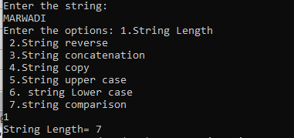
Example – All functions
{
printf("Enter the correct option:");
}
return 0;
}
}

Slide 57
Thank You!!

